Slide 1
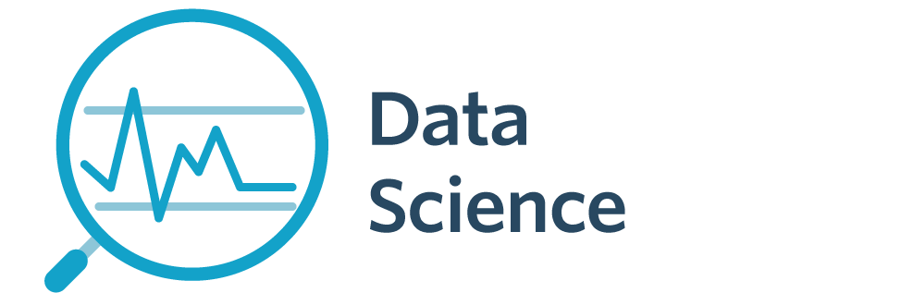

7143CEM Lecture 2: Week 3 Overview
School of Computing, Electronics and Mathematics Coventry University
7143CEM Programming for Data Science 2021/22 Semester 2

Slide 2
Intended Learning Outcomes
Demonstrate critical knowledge and systematic understanding of essential concepts of data science and computer programming.
Design, build, test, adapt and critique small programs in a high-level programming language.
Critically assess, select and apply data science tools, libraries or algorithms appropriate for various phases of the data science project lifecycle.
Notes:
We have already covered ILO2 so far in the module.

Slide 3
What is Data Science?
Alternative views:
1. A process of using data to understand things.
Data tell a story.
Uncover insights, patterns and trends.
Transforming data into knowledge that can guide decisions.
2. Science (apply the scientific method).
Observe some phenomenon and record observations (data).
Explore, formulate hypotheses, build models, make predictions.
Design experiments to confirm.
Notes:
Further reading: https://towardsdatascience.com/explaining-data-science-ai-ml-and-deep-learning-to-management-a-presentation-and-a-script-4968491eb1e5

Slide 4
What is Data Science?
3. The sum of its parts.
Artificial intelligence
Machine learning
Mathematics and statistics
Data analytics
Data engineering (extract, transform, load, clean)
Data visualisation
Algorithms and infrastructure
Data storage/retrieval
Domain/business knowledge

Slide 5
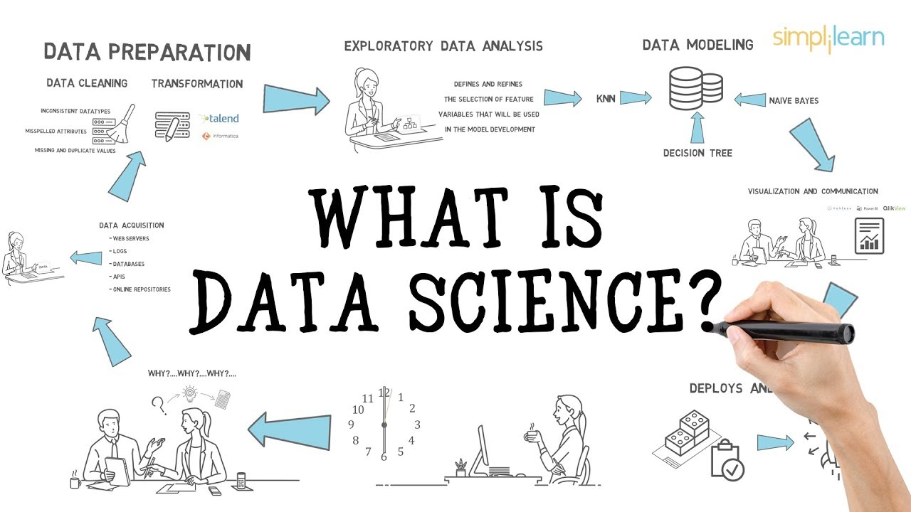
What is Data Science?
Notes:
Image: https://i.ytimg.com/vi/X3paOmcrTjQ/maxresdefault.jpg
Youtube: https://www.youtube.com/watch?v=X3paOmcrTjQ

Slide 6
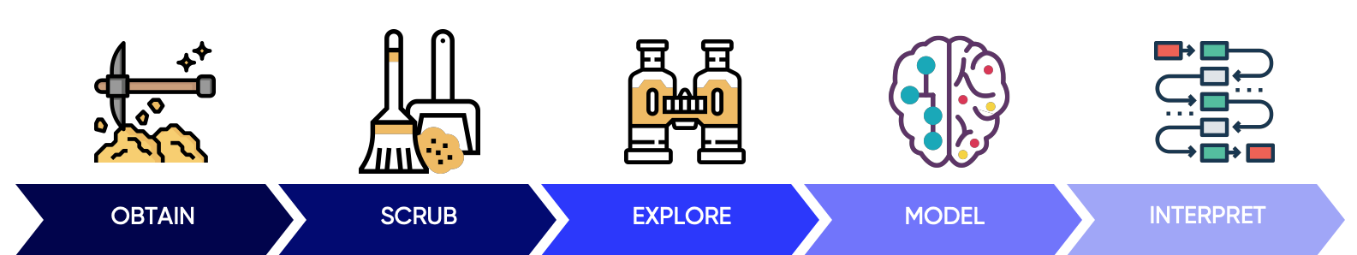
Data Science Project Lifecycle
Some common elements to a Data Science lifecycle / framework / pipeline / workflow.
OSEMN (“awesome”) pipeline model
https://machinelearningmastery.com/how-to-work-through-a-problem-like-a-data-scientist/
Notes:
OSEMN model from: https://towardsdatascience.com/5-steps-of-a-data-science-project-lifecycle-26c50372b492

Slide 7
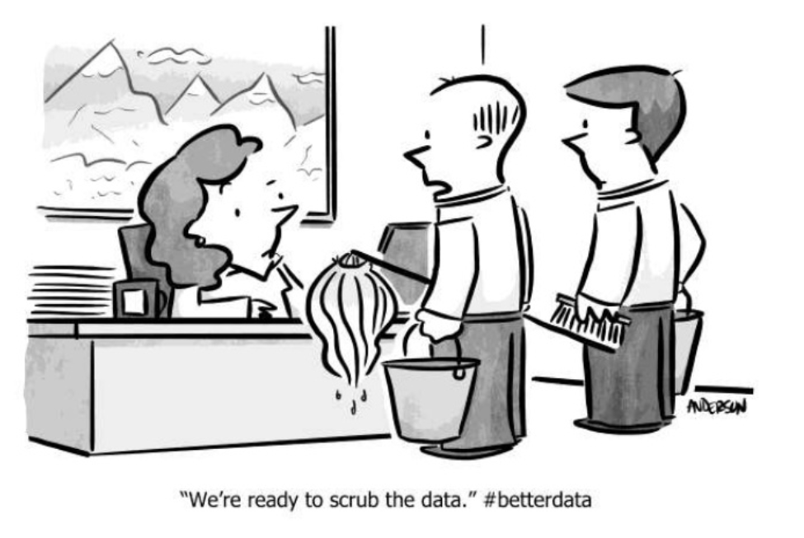
Data Science Project Lifecycle
Obtain – what data should be collected
Scrub – checking, correcting, organising, aggregating, selecting, normalising (e.g. 3NF)
Explore – graphical plots, summary statistics, identify outliers, form hypotheses
Model – explain, predict, classify
Interpret – give advice, form conclusions, follow up, critique (so what?)
Notes:
Image from: https://thelead.io/data-science/5-steps-to-a-data-science-project-lifecycle

Slide 8
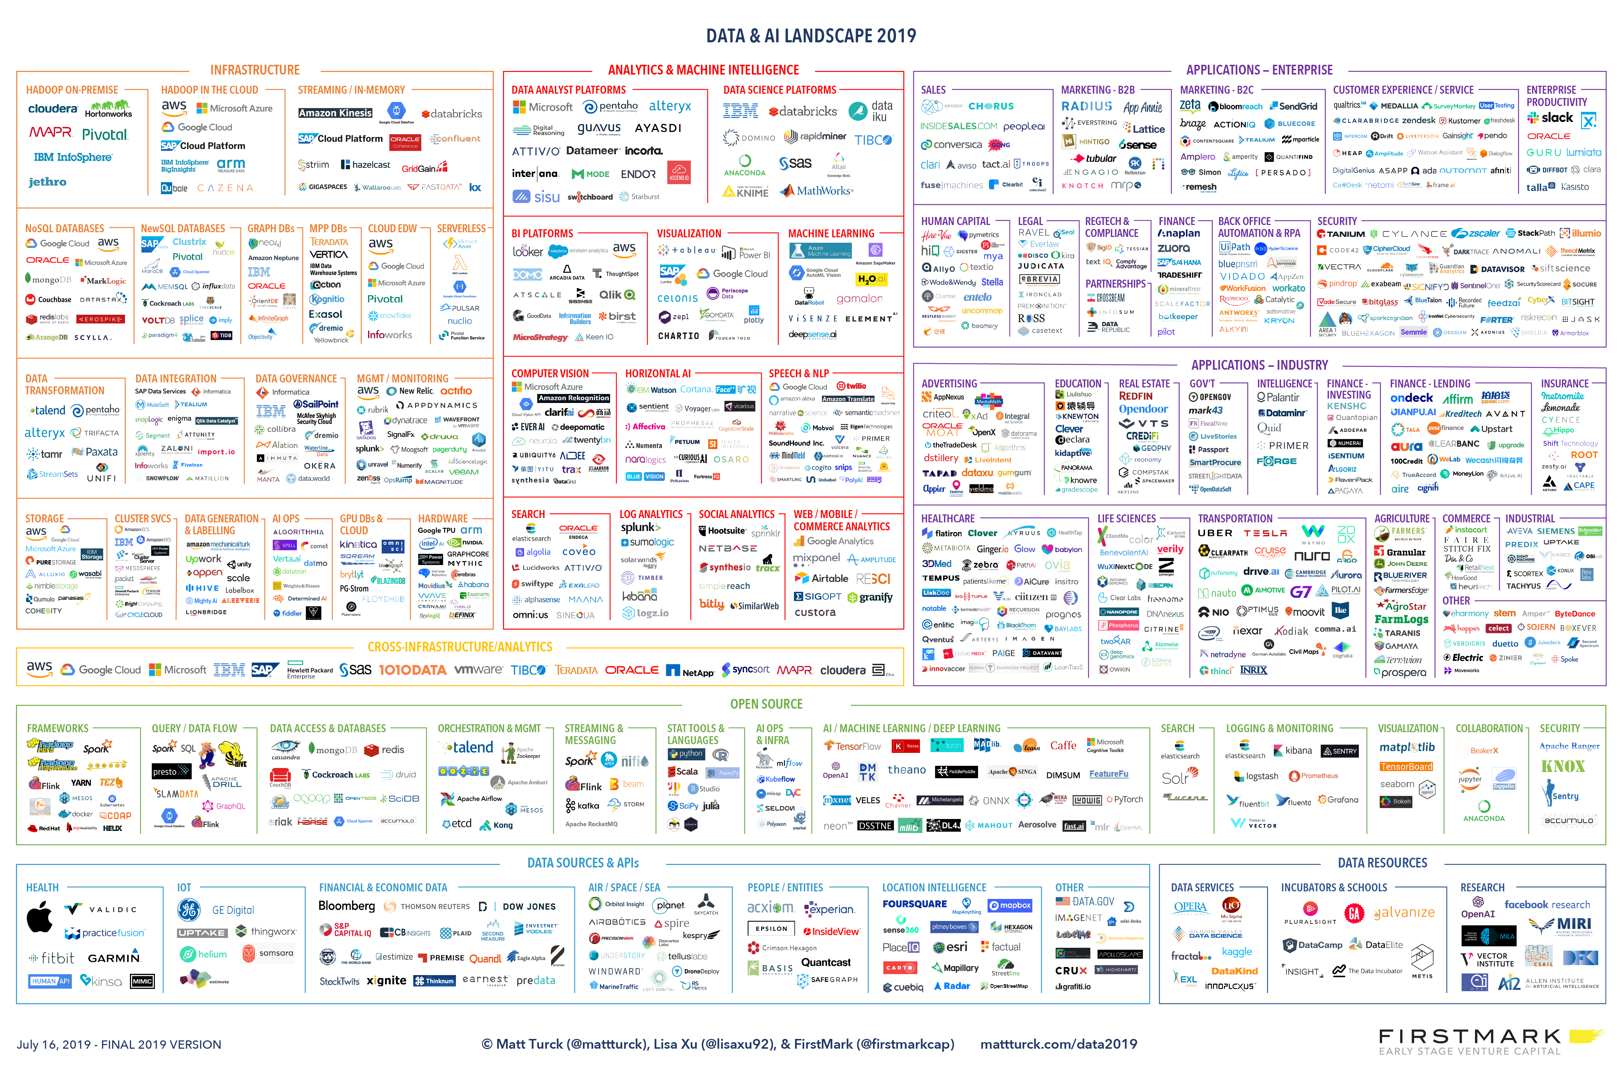
Data and AI Landscape
Notes:
Article: https://mattturck.com/data2019/
Full size image: http://mattturck.com/wp-content/uploads/2019/07/2019_Matt_Turck_Big_Data_Landscape_Final_Fullsize.png

Slide 9
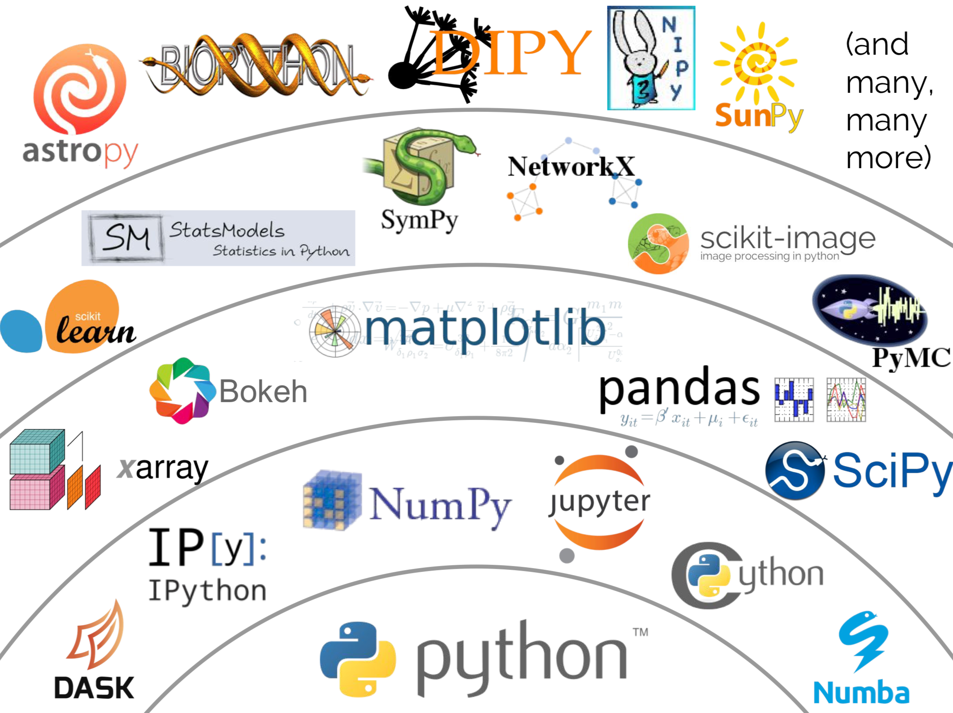
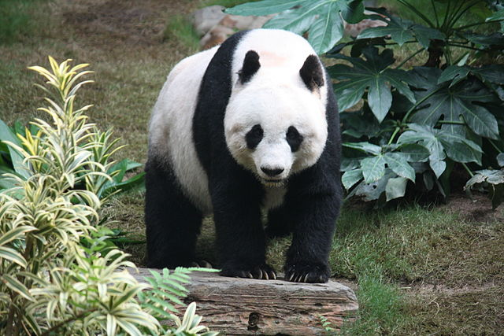
Python Data Science Libraries
Python (1990)
SciPy ecosystem/stack: NumPy (1995/2006) SciPy (2001) matplotlib (2003) pandas (2008)
Notes:
Image from: https://blueskyproject.io/
Original: https://speakerdeck.com/jakevdp/the-unexpected-effectiveness-of-python-in-science

Slide 10

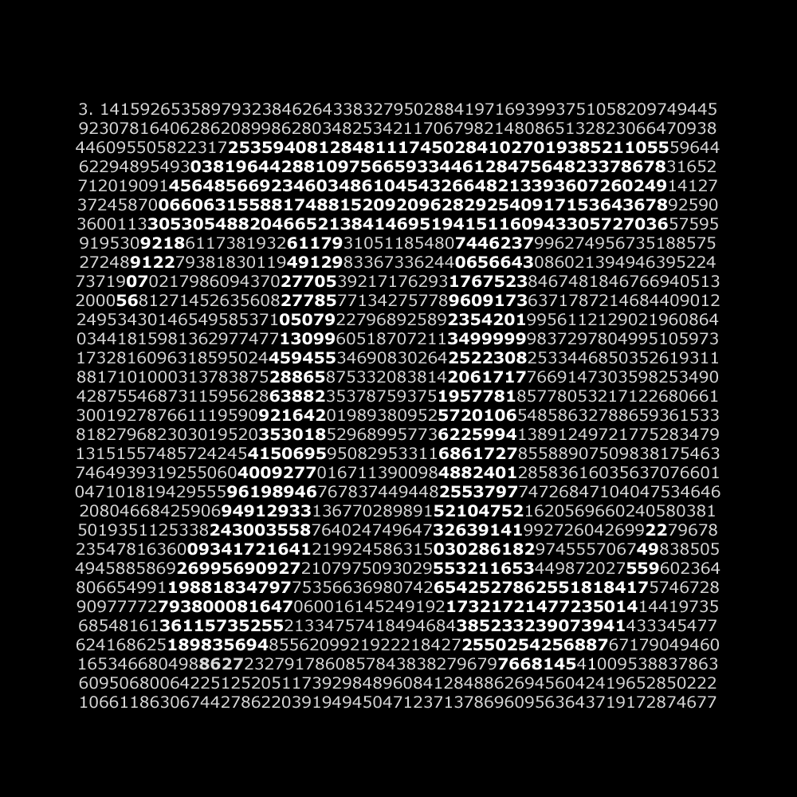
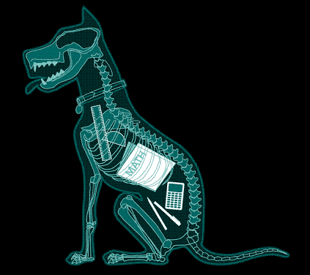
Example: SymPy
import sympy
sympy.pi.evalf(1000)
x = sympy.Symbol('x')
sympy.factor(x**3 – x**2 + x – 1)

Slide 11
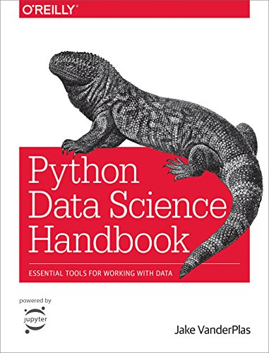
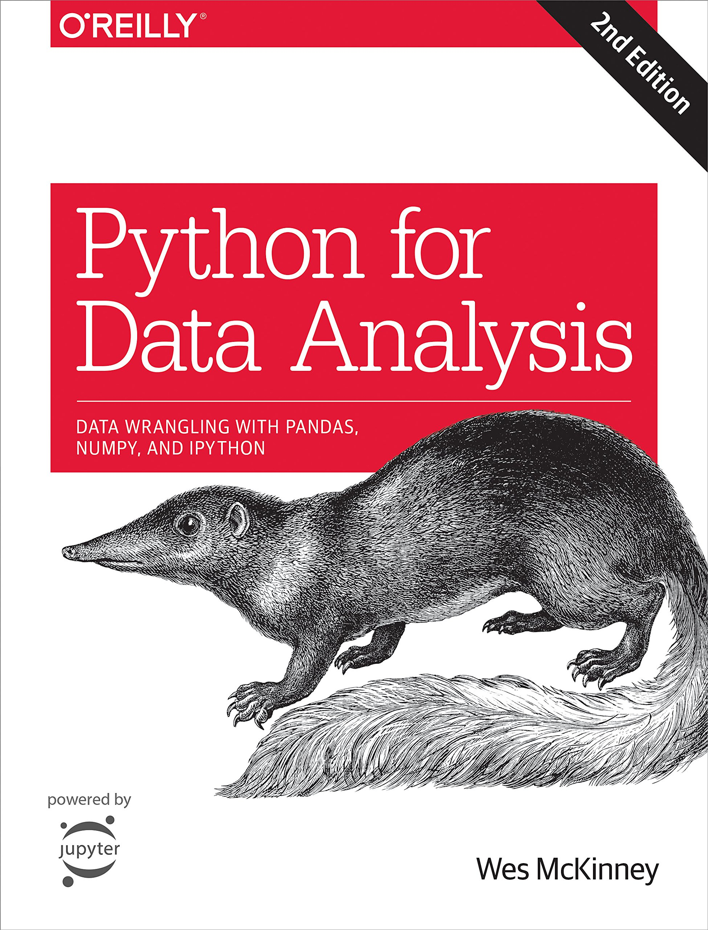

Recommended Reading
Jake VanderPlas, Python Data Science Handbook, O’Reilly, 2016. https://jakevdp.github.io/PythonDataScienceHandbook/
Wes McKinney, Python for Data Analysis (2ed), O’Reilly, 2017. Wes McKinney is the creator of pandas

Slide 12


Week 3 – Monday
Introduction to numpy and matplotlib
Reading: VanderPlas Chapter 2
Python list vs numpy array
numpy data types and attributes
Index, slice, stack, split
Vector operations and aggregations
Basic plots: bar graph, line graph, scatterplot

Slide 13


Week 3 – Tuesday
Introduction to pandas
Reading: VanderPlas Chapter 3
Pandas data structures (series and data frames)
Importing data
Data selection and filtering
Notes:
Image: Banksy

Slide 14
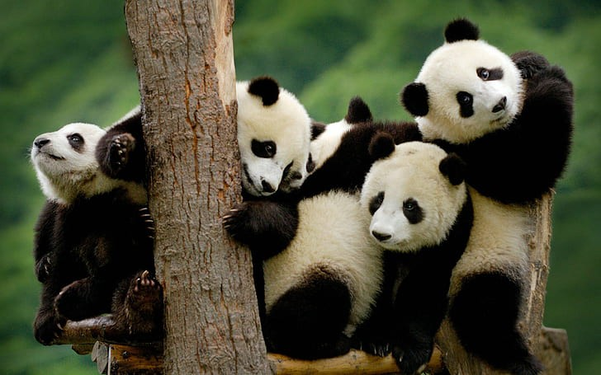
Week 3 – Wednesday
Exploratory Data Analysis with pandas
Reading: VanderPlas Chapter 3
Tidy data, values, types and variables
Data cleaning, missing values
Data grouping, aggregation and summaries

Slide 15



Week 3 – Thursday
Data Visualisation
Reading: VanderPlas Chapter 4
Graphical plots with pandas, seaborn (and matplotlib)
The Python Graph Gallery https://python-graph-gallery.com/

Slide 16



Week 3 – Fun Friday
Review / Q&A
Jupyter Notebook
Databases
Other Python libraries for Data Science

